Slide 1
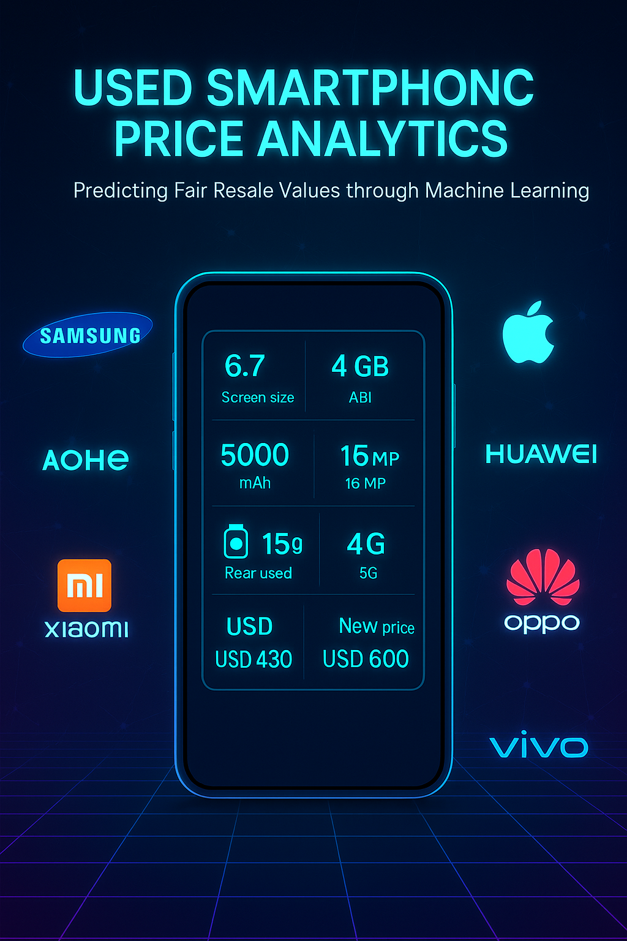
Predicting Fair Resale Prices for Used Smartphones
CSDA 6010 – Data Analytics Practicum
Sai Pratyusha Gorapalli | Webster University
Instructor: JP Wang | Fall 2025

Slide 2

The Challenge
• Inconsistent, guess-based pricing
• Customer dissatisfaction & lost revenue
• Complex market: brands, specs, conditions
• Need: transparent, data-driven pricing

Slide 3
Project Goals
• Regression → Predict exact resale value
• Classification → Assign to High/Low tiers
• Outcome: Fair, fast, and explainable pricing

Slide 4



WHY THESE GOALS
Goal 1: A consistent and competitive pricing framework for used smartphones is developed by selecting normalized_used_price as the target variable. This framework ensures that pricing decisions are data-driven and aligned with market patterns. At the same time, it guarantees that prices remain profitable for sellers while being fair to buyers, creating a balance that increases trust, encourages repeat sales, and strengthens long-term business relationships.
Goal 2: Produce a simple, customer-friendly classification output grade (High / Low)that staff can use for quick quoting and guardrails, keeping decisions uniform across stores.

Slide 5
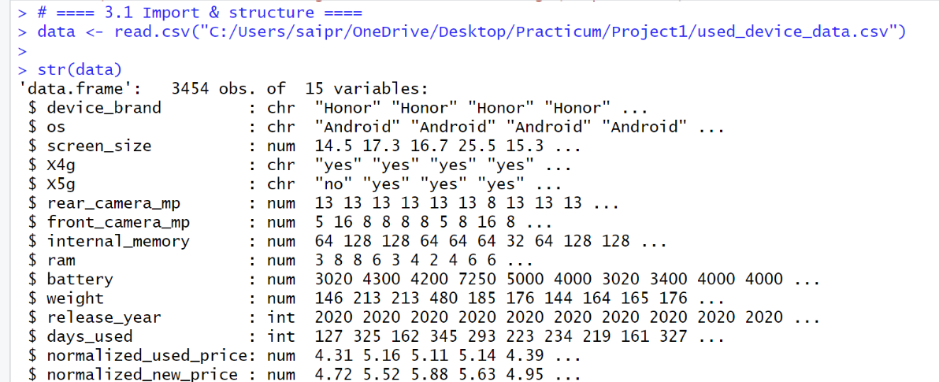
Dataset & Features
• 3,454 smartphones, 15 attributes
• Features: brand, OS, screen size, RAM, memory, cameras, battery, weight, release year, days used
• Targets: normalized_used_price

Slide 6
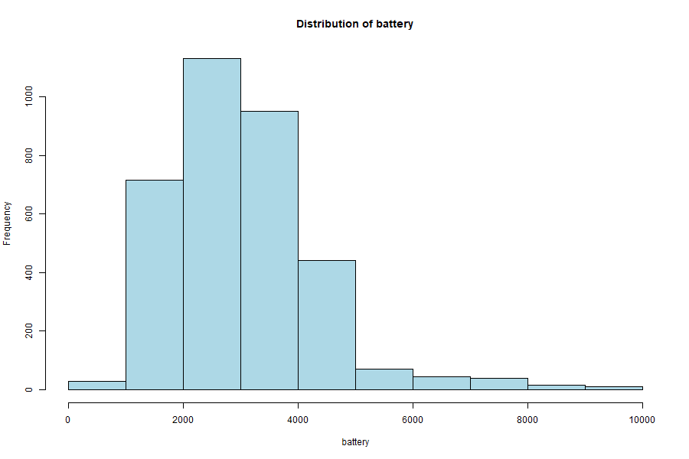
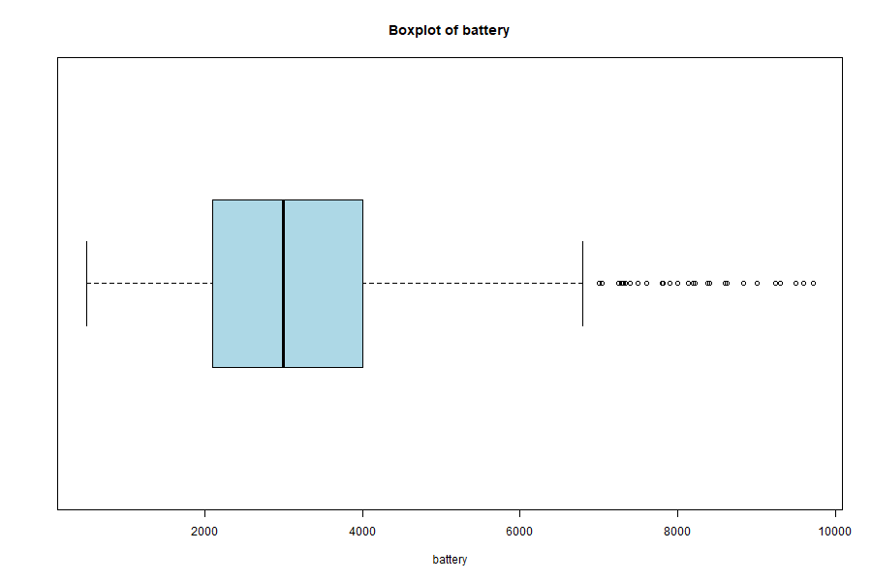
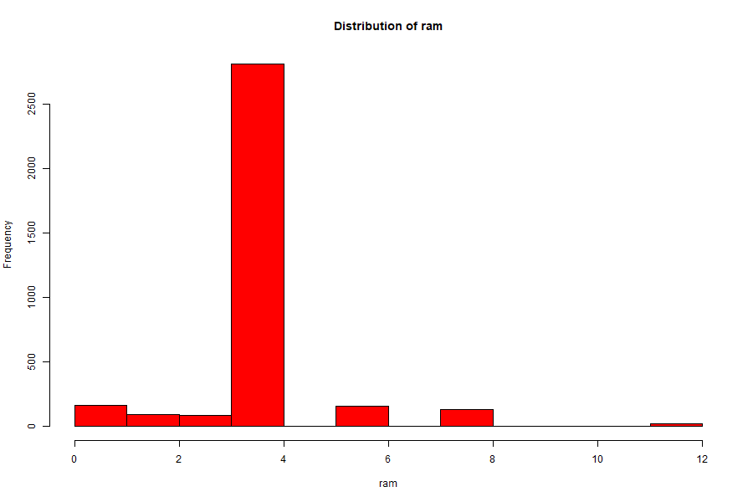
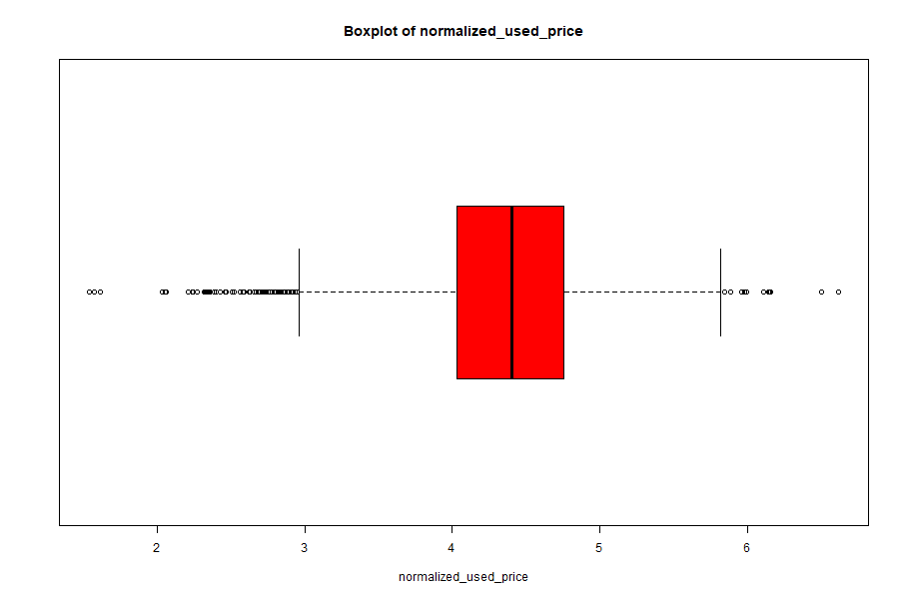
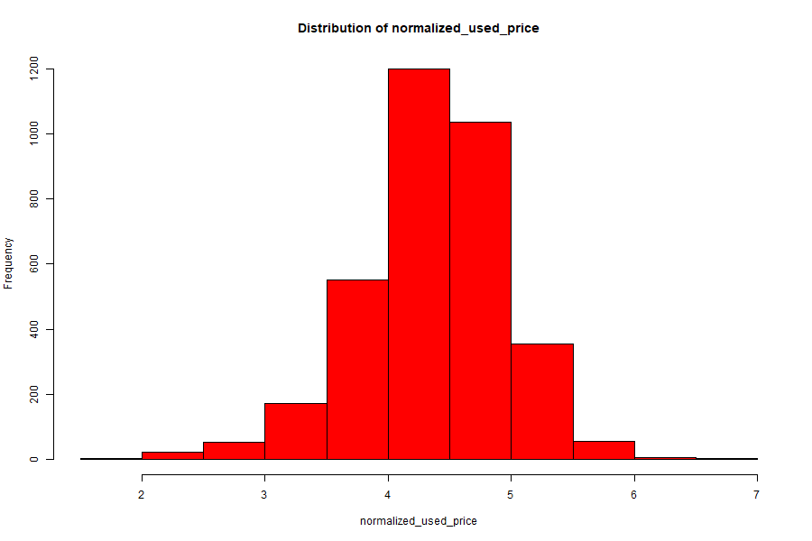
Exploration & Insights
• Battery: mostly 3000–4500 mAh
• RAM: peak at 4 GB, up to 12 GB
• Storage: 16–128 GB common, few up to 512 GB+
• Days used: ~2 years average

Slide 7

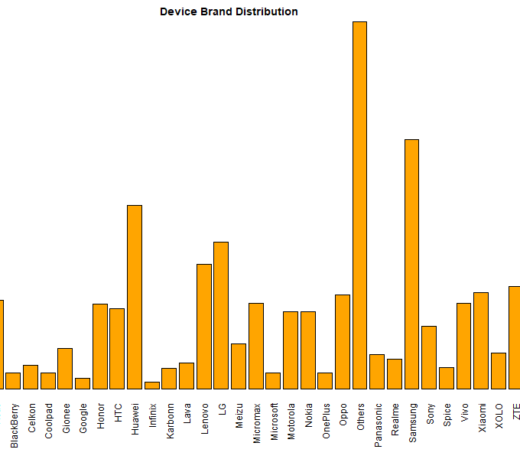
Insights into the datA
The dataset encompasses a diverse array of brands from both the premium and budget segments, including Samsung, Apple, Huawei, Oppo, Vivo, and others.
Samsung is the most common brand, with approximately above 350 devices, followed by Huawei.
Apple products are less common but usually have a higher resale value.

Slide 8
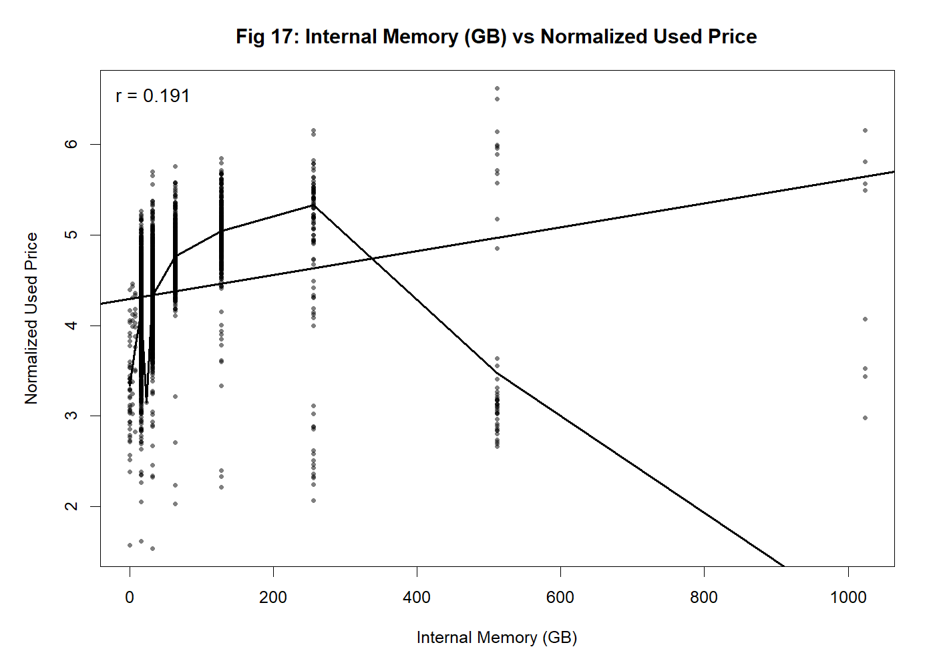
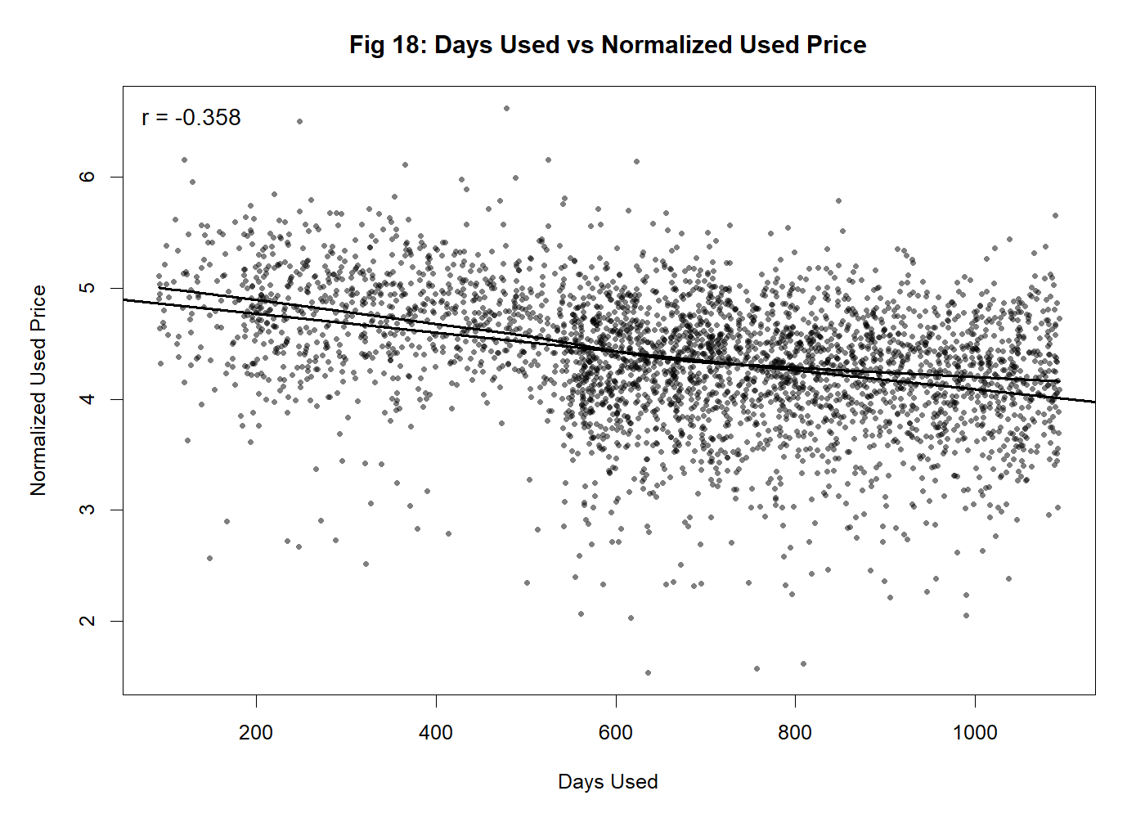
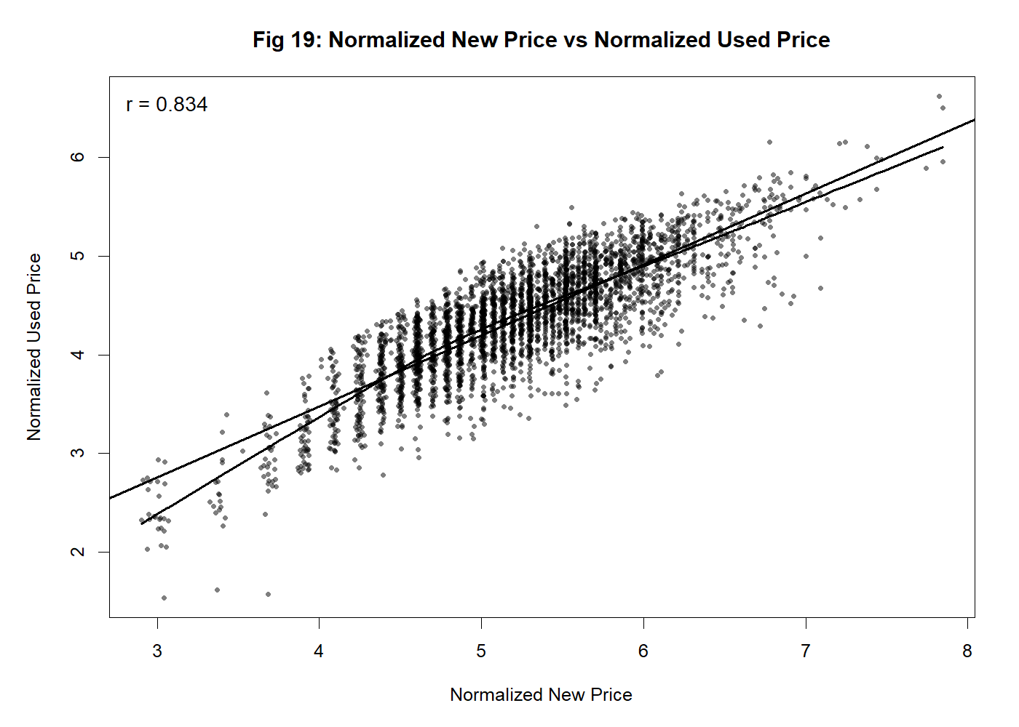
Predictor relevancy

Slide 9
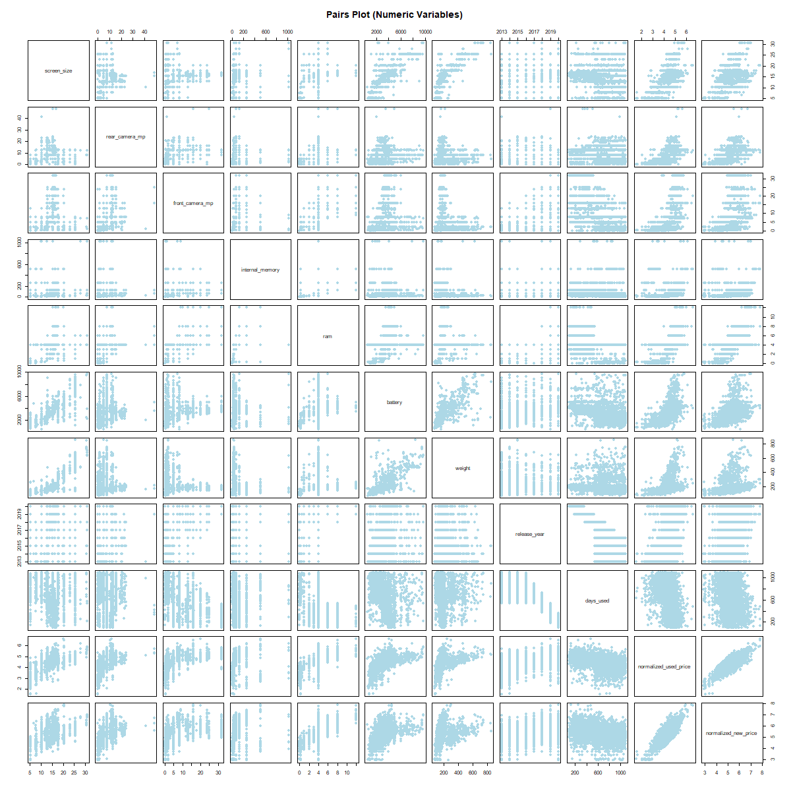
Correlation insights
The pairs plot indicates strong positive correlations:
Internal memory and RAM with normalized prices.
Battery capacity and weight show moderate correlation.
Confirms that specifications strongly drive resale pricing.

Slide 10
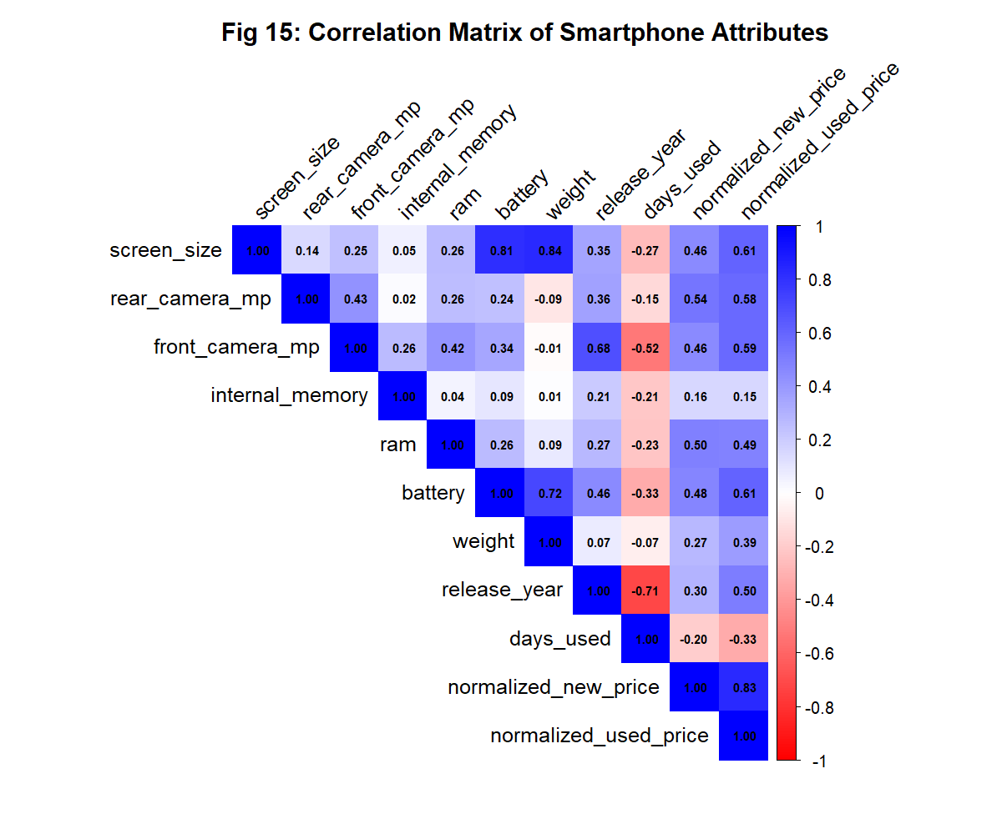
Correlation Insights
• Strong: memory, RAM, new price
• Moderate: battery, weight
• Negative: days used

Slide 11
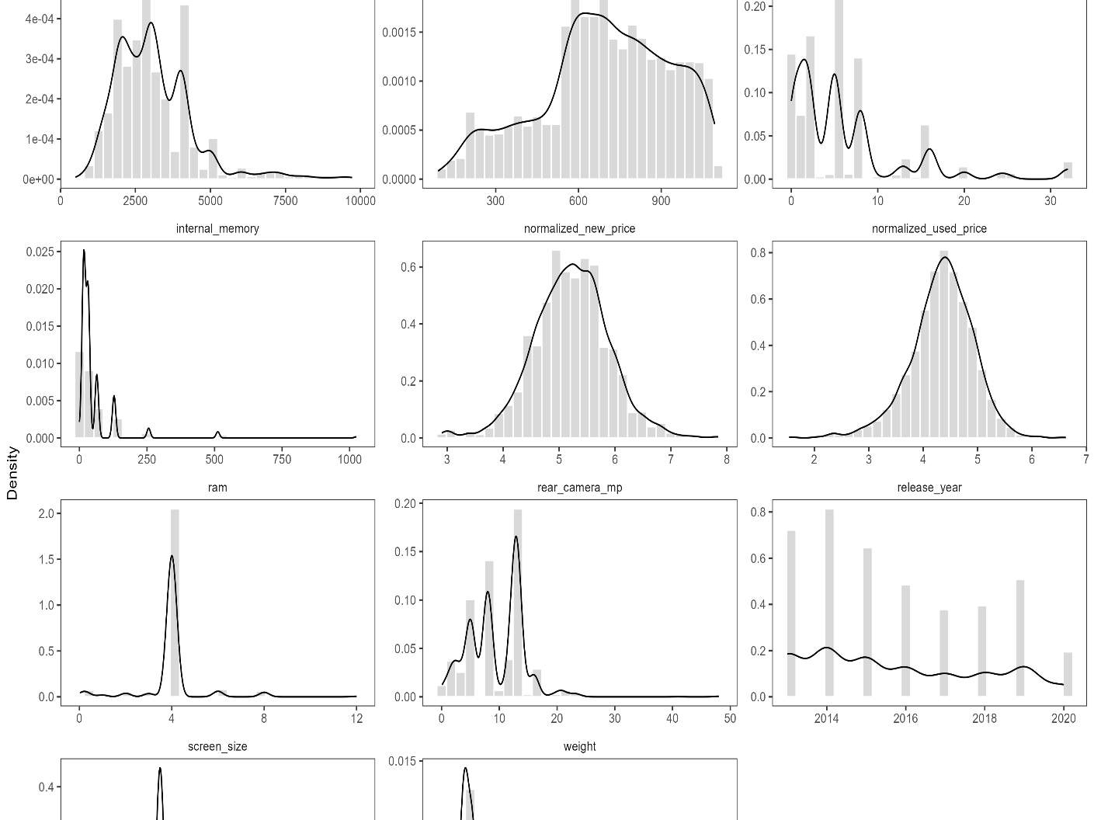
DATA PREPROCESSING and exploration
Handling Missing values, removing zeros, NA values, checked for duplicate values.
Made sure to not remove zero of rear_camera_mp or front_camera_mp.
Removing variables which have low correlation, (r = 0.15).
Removed any outliers existing, by applying quantile-based filtering on extreme values of numerical features.
categorical variables were converted into numerical dummy columns before fitting the models.
Used Kernel density estimation to reveal skew and outliers

Slide 12
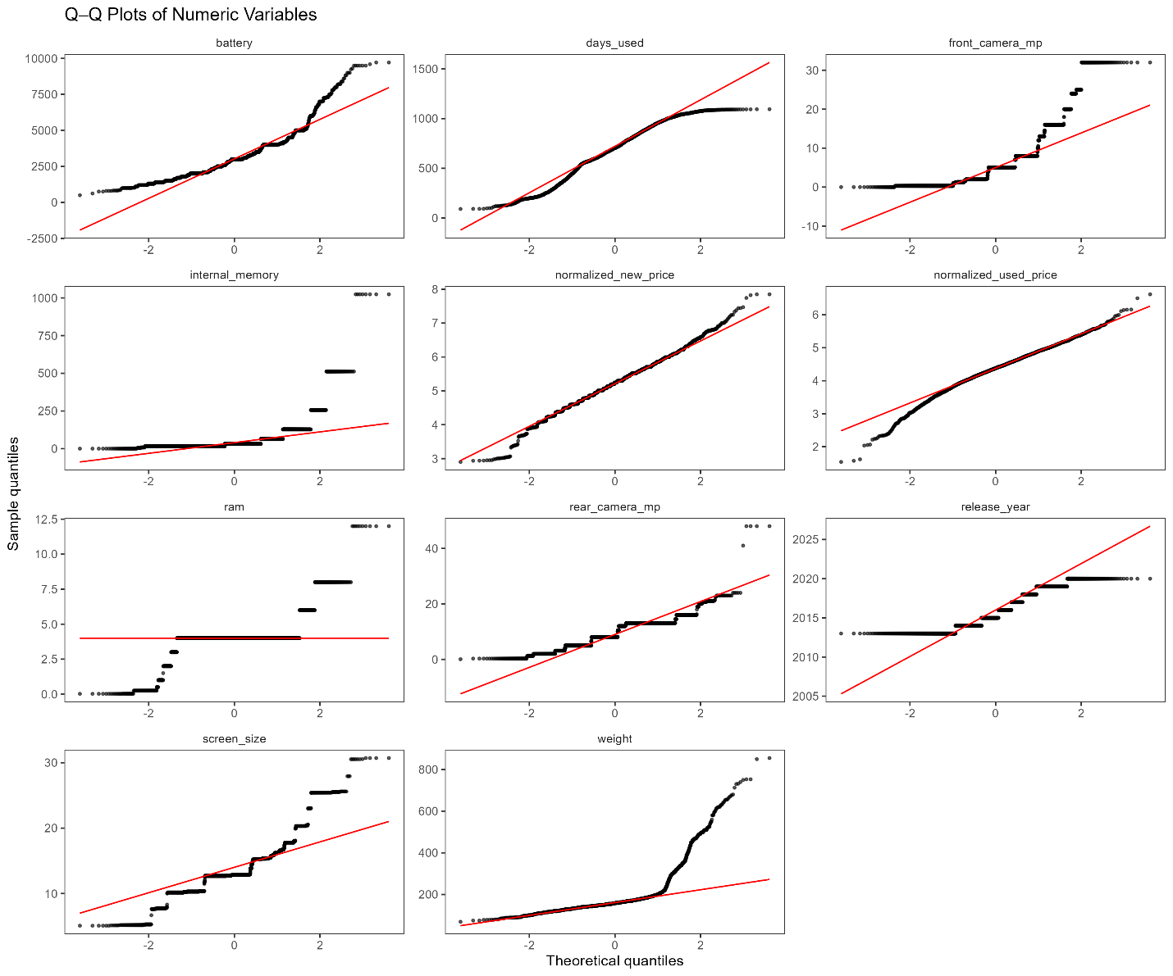
The Q-Q plot displays data distribution in comparison to the predicted normal distribution. The observations should roughly fall on a straight line for data that is normally distributed.

Slide 13

DATA PARTITONING
The data set is divided into 3 sets:
Training Set (70%) – used to fit the model.
Validation Set (15%) – used to tune/compare models and avoid overfitting.
Testing Set (15%) – kept aside until the end for an unbiased final evaluation.
This 70–15–15 split gives enough data to learn, enough to tune, and a clean hold-out to judge final performance. The validation set helps improve model performance before testing. We predict log_used_price. To keep the split balanced, we create simple bins of the target and sample within bins.

Slide 14

ALGORITHM SELECTION AND APPROACH TO EACH ALGORITHM
MULTIPLE LINEAR REGRESSION
KNN
RANDOM FOREST
C5.0
LOGISTIC REGRESSION
Each Algorithm has a different approach.
Applied normalization and standardization on algorithms like KNN and Random Forest while they were not necessary for others.
Handled factors in Multiple linear regression.

Slide 15
Multiple Linear Regression (MLR): Chosen to capture the linear relationship between smartphone specifications (RAM, battery, memory, etc.) and resale price; data was standardized so coefficients are comparable.
k-Nearest Neighbors (kNN): Applied to estimate price based on similarity to nearby devices; normalization was essential because kNN is distance-based.
Random Forest: Used to improve accuracy and reduce overfitting through ensemble learning; normalization not required since trees handle raw feature scales. C5.0 Classification Tree: Chosen to classify smartphone prices into categories (such as high vs low) using rule-based splits on specifications; normalization was not required since tree-based algorithms are scale-independent.
Logistic Regression (for classification): Used to classify devices into high/low price categories; features were standardized to stabilize coefficients and improve convergence.

Slide 16

Models Compared
MODEL | MAE | MSE | RMSE | R SQUARE
Multiple Linear Regression | 0.1633 | 0.0406 | 0.2015 | 0.7862
K-NN (k=15) | 0.1746 | 0.0472 | 0.2173 | 0.7515
Random Forest | 0.1714 | 0.0452 | 0.2126 | 0.7622
• Regression: Multiple Linear Regression, k-NN, Random Forest
• Classification: Logistic Regression, C5.0 Decision Tree
• Performance compared using RMSE, R², Accuracy
Validation Comparison:

Slide 17
COMPARISON OF MODELS IN CLASSIFICATION
MODEL | ACCURACY | SENSITIVITY | SPECIFICITY | KAPPA | BALANCED ACC
C5.0 | 0.8640 | 0.8683 | 0.8598 | 0.7281 | 0.8640
Logistic Regression | 0.8731 | 0.8683 | 0.8780 | 0.7462 | 0.8732
Validation comparison:

Slide 18
Best Performing Models
• Regression Winner: Multiple Linear Regression (RMSE 0.2006, R² 0.7821)
• Classification Winner: Logistic Regression (Accuracy 86.3%)

Slide 19

BusinesS Value
• 🤝 Trust → Fair deals
• 📈 Profitability → Maximize revenue
• 🔄 Efficiency → Fast & consistent intake decisions

Slide 20
CONCLUSION & Business recommendation
Both models of Multi Linear Regression and Logistic Regression should be used, to get precise resale value and for validation as a double check.
As well as in case of special occasions businesses give discounts, they can use the second model to see which band the smartphone goes into, “high” yes can give discounts.
Get stock with good RAM and internal memory, which not only attracts customers but also has high resale price ensuring the business profit.

Slide 21
Conclusion & Future
• Machine learning enables fair & transparent smartphone resale pricing
• Models balance accuracy & explainability
• Future: retraining with new devices & dynamic tiers

Slide 22

HOPE YOU HAVE A PROFITABLE business, thank you

